Slide 1

Interface in JAVA
Prepared By: Dimple Bohra

Slide 2
What is an interface?
An interface in java is a blueprint of a class. It has static constants and abstract methods.
The interface in Java is a mechanism to achieve abstraction.
There can be only abstract methods in the Java interface, not method body.
It is used to achieve abstraction and multiple inheritance in Java.
In other words, you can say that interfaces can have abstract methods and variables. It cannot have a method body.
It cannot be instantiated just like the abstract class.

Slide 3
Points to remember
Like abstract classes, interfaces cannot be used to create objects
Interface methods do not have a body
On implementation of an interface, you must override all of its methods
Interface methods are by default abstract and public
Interface data members are by default public, static and final
An interface cannot contain a constructor (as it cannot be used to create objects)

Slide 4
Why And When To Use Interfaces?
To achieve security - hide certain details and only show the important details of an object (interface).
Java does not support "multiple inheritance" (a class can only inherit from one superclass). However, it can be achieved with interfaces, because the class can implement multiple interfaces.
Note: To implement multiple interfaces, separate them with a comma.

Slide 5
How to declare an interface?
An interface is declared by using the interface keyword.
It provides total abstraction; means all the methods in an interface are declared with the empty body, and all the fields are public, static and final by default.
A class that implements an interface must implement all the methods declared in the interface.
Syntax: interface <interface_name>
{ // declare constant fields
// declare methods that are abstract by default
}

Slide 6
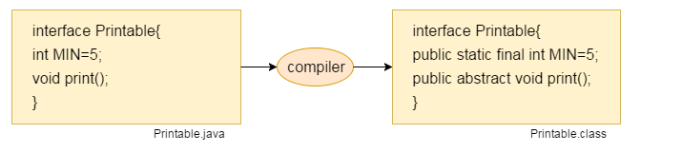
What happens at compile time?
The Java compiler adds public and abstract keywords before the interface method.
Moreover, it adds public, static and final keywords before data members.

Slide 7
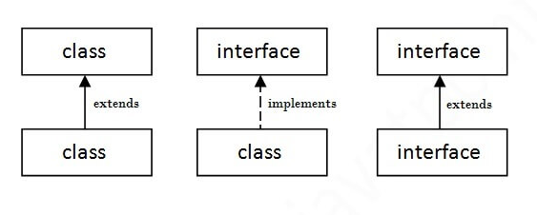
Relationship between class and interface

Slide 8
Interface example
interface printable
{
void print();
}
class TestInterface implements printable
{
public void print()
{
System.out.println("Hello");
}
public static void main(String args[])
{
TestInterface obj = new TestInterface();
obj.print();
}
}
Notes:
In a real scenario, an interface is defined by someone else, but its implementation is provided by different implementation providers. Moreover, it is used by someone else. The implementation part is hidden by the user who uses the interface.

Slide 9
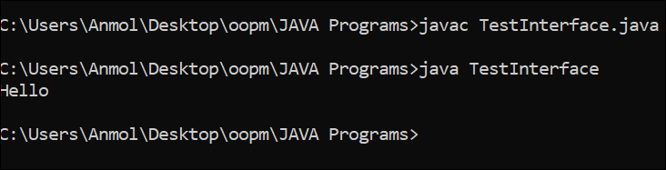
interface printable{
void print();
}
class TestInterface implements printable{
public void print()
{
System.out.println("Hello");
}
public static void main(String args[])
{
TestInterface obj = new TestInterface();
obj.print();
}
}

Slide 10
//Interface declaration: by first user
interface Drawable
{
void draw();
}
//Implementation: by second user
class Rectangle implements Drawable
{
public void draw()
{
System.out.println("drawing rectangle");
} }
class Circle implements Drawable
{
public void draw()
{
System.out.println("drawing circle");
} }
//Using interface: by third user
class TestInterface1
{
public static void main(String args[])
{
Drawable d=new Circle();
d.draw();
}}

Slide 11
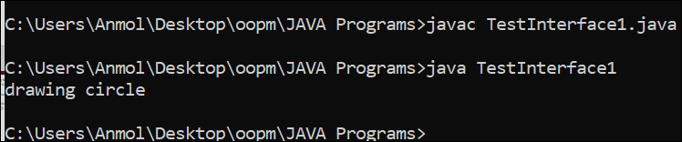
//Interface declaration: by first user
interface Drawable
{
void draw();
}
//Implementation: by second user
class Rectangle implements Drawable
{
public void draw()
{
System.out.println("drawing rectangle");
} }
class Circle implements Drawable
{
public void draw()
{
System.out.println("drawing circle");
} }
//Using interface: by third user
class TestInterface1
{
public static void main(String args[])
{
Drawable d=new Circle();
d.draw();
}}

Slide 12
Interface example
interface Bank
{
float rateOfInterest();
}
class SBI implements Bank
{
public float rateOfInterest()
{
return 9.15f;
} }
class PNB implements Bank
{
public float rateOfInterest()
{
return 9.7f;
} }
class TestInterface2
{
public static void main(String[] args)
{
Bank b=new SBI();
System.out.println("ROI: "+b.rateOfInterest());
} }

Slide 13
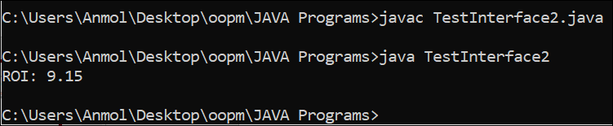
Interface example
interface Bank
{
float rateOfInterest();
}
class SBI implements Bank
{
public float rateOfInterest()
{
return 9.15f;
} }
class PNB implements Bank
{
public float rateOfInterest()
{
return 9.7f;
} }
class TestInterface2
{
public static void main(String[] args)
{
Bank b=new SBI();
System.out.println("ROI: "+b.rateOfInterest());
} }

Slide 14
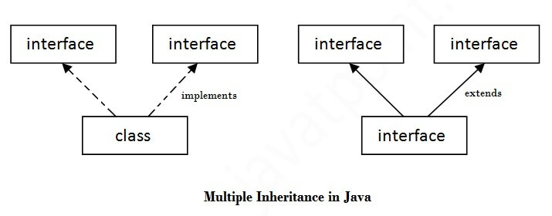
Multiple Inheritance in Java by Interface
If a class implements multiple interfaces, or an interface extends multiple interfaces, it is known as multiple inheritance.

Slide 15
Interface example
class TestInterface3 implements Printable, Showable
{
public void print()
{
System.out.println("Welcome");
}
public void show()
{
System.out.println("Back");
}
public static void main(String args[])
{
TestInterface3 obj = new TestInterface3();
obj.print();
obj.show();
}
}
interface Printable
{
void print();
}
interface Showable
{
void show();
}

Slide 16
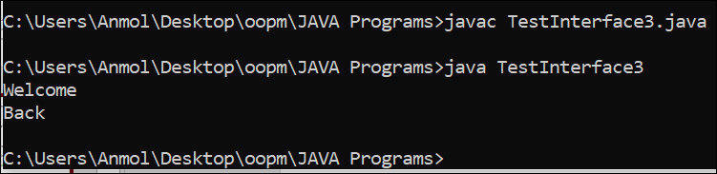
Interface example
class TestInterface3 implements Printable, Showable
{
public void print()
{
System.out.println("Welcome");
}
public void show()
{
System.out.println("Back");
}
public static void main(String args[])
{
TestInterface3 obj = new TestInterface3();
obj.print();
obj.show();
} }
interface Printable
{
void print();
}
interface Showable
{
void show();
}

Slide 17
Interface example
interface Printable
{
void print();
}
interface Showable
{
void print();
}
class TestInterface4 implements Printable, Showable
{
public void print()
{
System.out.println("Hello D10A");
}
public static void main(String args[])
{
TestInterface4 obj = new TestInterface4();
obj.print();
}
}

Slide 18
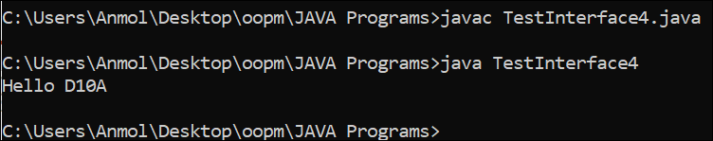
class TestInterface4 implements Printable, Showable
{
public void print()
{
System.out.println("Hello D10A");
}
public static void main(String args[])
{
TestInterface4 obj = new TestInterface4();
obj.print();
}
}
interface Printable
{
void print();
}
interface Showable
{
void print();
}

Slide 19
Interface Inheritance
A class implements an interface, but one interface extends another interface.
interface Printable
{
void print();
}
interface Showable extends Printable
{
void show();
}

Slide 20
public static void main(String args[])
{
TestInterface5 obj = new TestInterface5();
obj.print();
obj.show();
}
}
interface Printable
{
void print();
}
interface Showable extends Printable
{
void show();
}
class TestInterface5 implements Showable
{
public void print()
{
System.out.println("WELCOME TO VESIT");
}
public void show()
{
System.out.println("INFT DEPARTMENT");
}

Slide 21
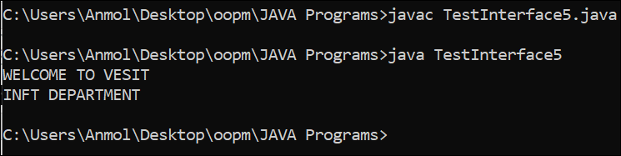
public static void main(String args[])
{
TestInterface5 obj = new TestInterface5();
obj.print();
obj.show();
}
}
interface Printable
{
void print();
}
interface Showable extends Printable
{
void show();
}
class TestInterface5 implements Showable
{
public void print()
{
System.out.println("WELCOME TO VESIT");
}
public void show()
{
System.out.println("INFT DEPARTMENT");
}

Slide 22
public static void main(String args[])
{
TestInterface5 obj = new TestInterface5();
obj.print();
obj.show();
}
}
interface Printable{
void print();
}
interface Showable extends Printable{
private void show();
}
class TestInterface5 implements Printable
{
public void print()
{
System.out.println("WELCOME TO VESIT");
}
public void show()
{
System.out.println("INFT DEPARTMENT");
}

Slide 23
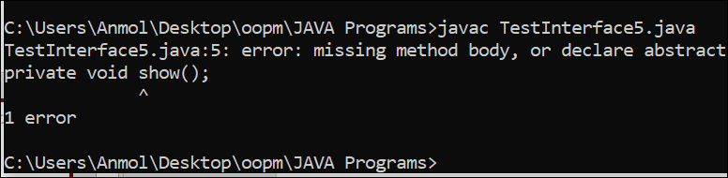
public static void main(String args[])
{
TestInterface5 obj = new TestInterface5();
obj.print();
obj.show();
}
}
interface Printable{
void print();
}
interface Showable extends Printable{
private void show();
}
class TestInterface5 implements Printable
{
public void print()
{
System.out.println("WELCOME TO VESIT");
}
public void show()
{
System.out.println("INFT DEPARTMENT");
}

Slide 24
Thank You!!!

